Slide 1


Computer Cases
By: Ahmad Waqar
Group : BCS/A

Slide 2


Introduction
what is computer case ?
What is the importance of computer case ?
What are the types of computer case ?
What cmponents of computer case

Slide 3
COMPUTER CASE
A computer case a protective enclosure for essential components of a computer.
Just like a skeleton in our body which protects the internal organs
Components of computer are useless except a computer case

Slide 4
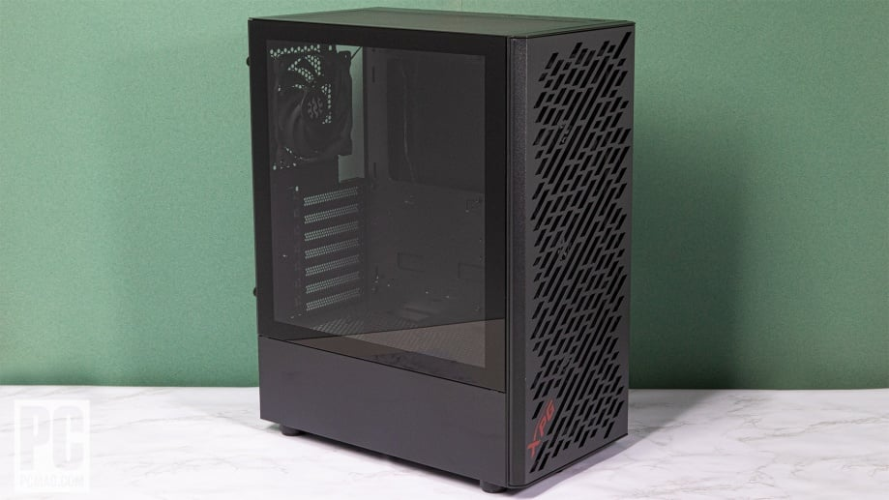
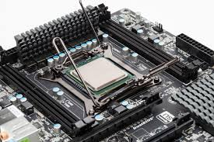
Computer case / CPU

Slide 5
Tower cases
Full tower
Mid tower
Mini tower
TYPES OF COMPUTER CASE

Slide 6
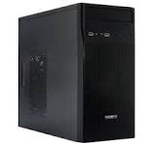
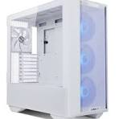
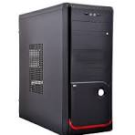
Visual Representation
Mini tower
Full tower
Mid tower

Slide 7
Major Differences
Feature
Mid Tower
Mini Tower
Full Tower
Motherboard Support | ATX, micro-ATX, mini-ITX | micro-ATX, mini-ITX | E-ATX, ATX, micro-ATX, mini-ITX
Expandability | Moderate – multiple drives, 1-2 GPUs, decent cooling | Limited – fewer drives, smaller GPUs, limited cooling | Extensive – multiple GPUs, lots of storage, advanced cooling
Use Case | General-purpose use, gaming | Budget builds, office setups | High-end gaming, professional workstations

Slide 8
Motherboard Supported Ports
MINI TOWER
MICRO ATX
MINI ITX
FULL TOWER
E-ATX
ATX PORT
MINI ITX
MICRO ATX
MID TOWER
ATX
MINI ITX
MICRO ATX

Slide 9
Thank you

